Slide 1
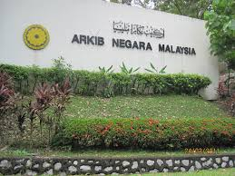
CHAPTER 3
MANAGEMENT OF
ARCHIVES ADMINISTRATION
3.1 Internal Structure And Organization
3.2 Acquisition And Appraisal Of Archives

Slide 2
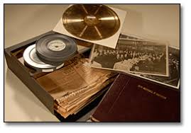
Basically, the focus of archival administration is the preservation and care of unique records of action taken by a group, government agency, organization, or company.

Slide 3

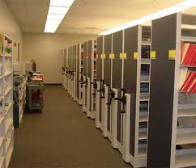
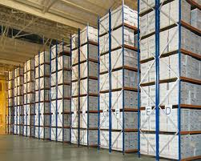
3.1 Internal Structure And Organization
Archival institution will divide its structure into four groups:
Repository
Search Room or Reference Area
Finding Aids and Publications
Preservation Services

Slide 4
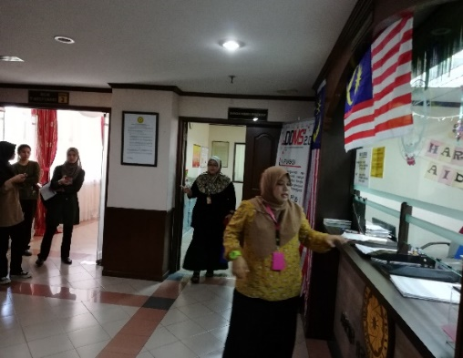
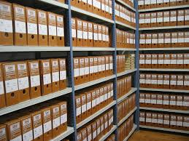
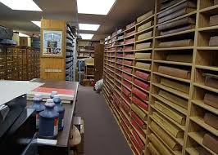
Repository
Repository activities connected with the:
reception of new archival material into custody
the preservation of this material in storage
provision of equipment for this purpose
maintenance of the storage areas (the repository itself)
administrative control of materials, especially arrangement of the materials, movement of materials into and out of the repository and from place to place within it
security of the repository.

Slide 5
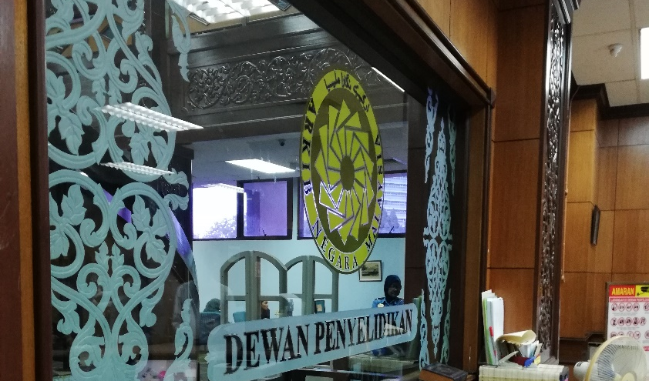
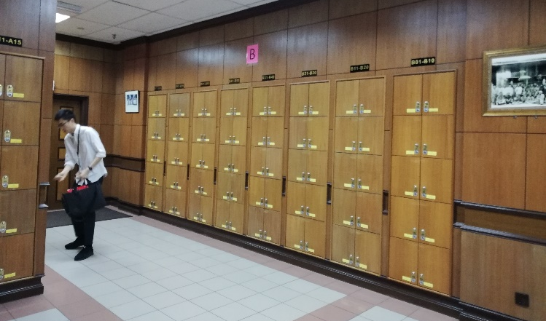
ii. Search room or reference area
Functions:
Provision of facilities for users.
Maintain as a suitable environment for the consultation of archival materials;
Control of registration and conduct of users.
Focus on procedures for ordering, issue and return of archival materials;
Provision and management of copying facilities.

Slide 6
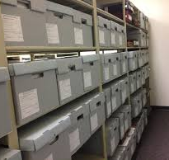
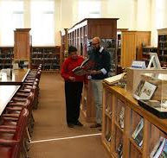
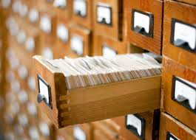
iii. Finding aids and publications
Finding Aids and Publications Activities:
Intellectual control of the holdings
Preparation and publication of a guide to the holdings
Research and analysis
Preparation of lists, indexes and other finding aids
Other publications; exhibitions and outreach activities.

Slide 7
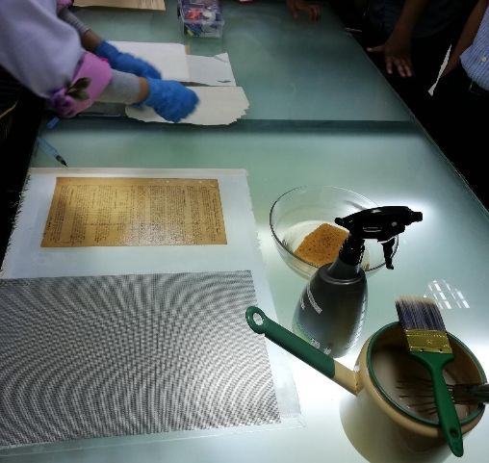
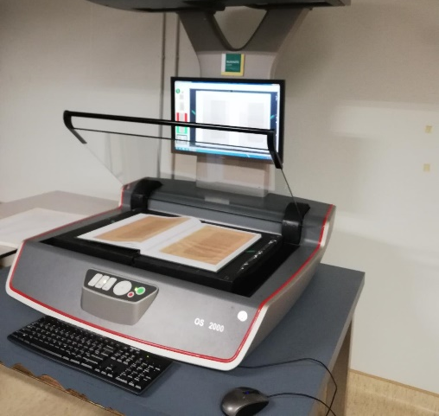
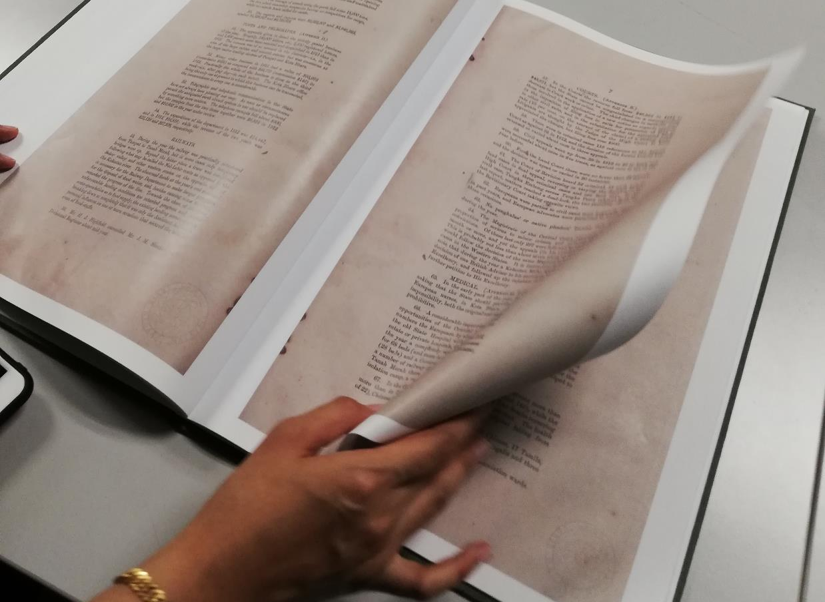
Preservation services
Preservation activities connected with the:
Maintenance and monitoring of the environmental conditions in the repository.
Conservation and repair facilities and programs;
Copying and photographic equipment and programmes.

Slide 8

3.2 Acquisition And Appraisal Of Archives
Acquisition
3.2.1 Receiving Archival Materials
3.2.2 Methods of Acquisition
Appraisal 3.2.3 Appraisal of archival materials

Slide 9


